Slide 1

erious
S
A
D
bout
ata
Andrew Ramzy
Data Scientist
Menna Mustafa
Computer Engineering
Student
Abdullah Tarek
Computer Science
Student
Mahmoud Salem
Computer Science
Student

Slide 2





THE PROBLEM
Identification of
Insurance Company
Claim
Department
Other
Departments
Notes:
150 claims

Slide 3



THE SOLUTION
Intuition of
CLAIMS
Automation + Ranking
SUSPICIOUS CLAIMS
High
Medium
32%
PASS
Low
68%

Slide 4
THE FRAMEWORK
Intuition of
Simulation:
F. SCORE
3!!!
2!!
1!
0
1!
2!!
3!!!
Notes:
Results

Slide 5
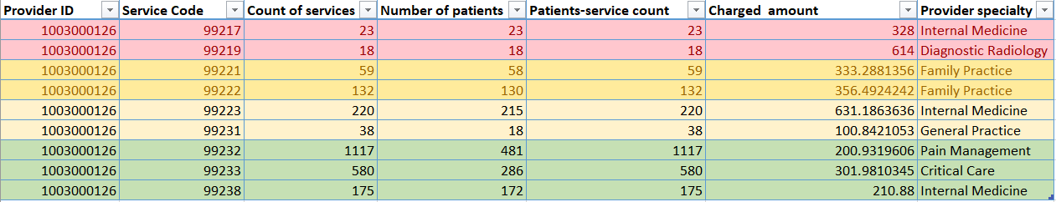
THE Results
The given
Provider-Service Level
Service Level
Provider level
1%
4%
24%
71%
High ( Tier 3 )
6%
16%
54%
24%
Medium ( Tier 2 )
Low ( Tier 1 )
Accepted

Slide 6
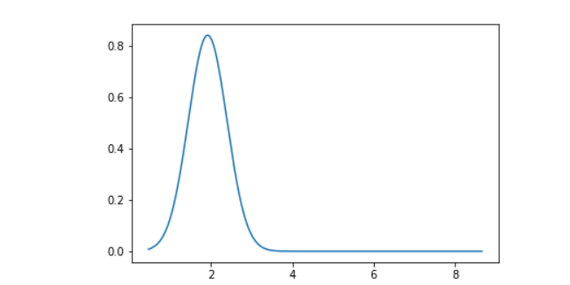
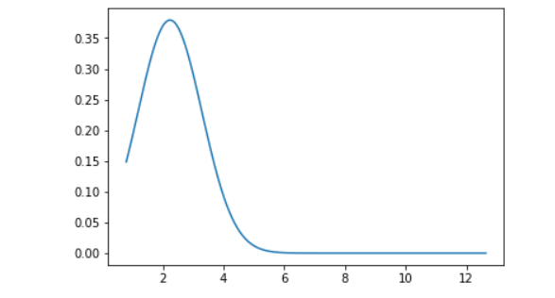
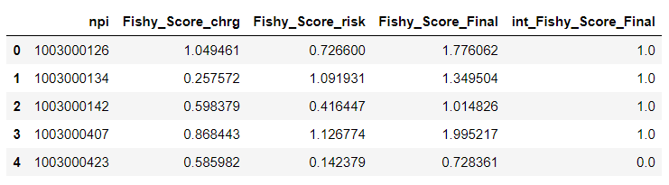
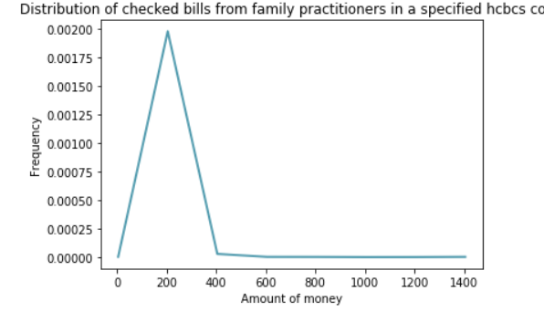
STEPS TAKEN
The way of
Data set used:
The Given data set (Aggregate Dataset) (1M Provider)
Detailed dataset (We got) (10M Provider-Service)
Tools:
Python
R
On provider-service level
features
Service charge per specialty
Average risk score for patients per specialty
Number of services per provider specialty
Average risk in cardiology
Average risk in ambulances
Distribution of checked bills in specified hcpcs code

Slide 7
FUTURE WORK
The possibilities of
Pilot > Test > Tweak > Repeat
Claim Level Dataset = higher accuracy
Considering Age Groups
Considering Gender
Considering Geographical Areas
Weighted Average by Time
Interface design:

Slide 8
THANK YOU

